Slide 1
Morphology
Morphology is the study of words
Study's internal structure of words
How words change their form to generate new word
Different role they play in sentence ,strictly following linguistic rule.

Slide 2
Morphemes
words are built from smaller meaningful grammatical units called morphemes.
dogs
2 morphemes, ‘dog’ and ‘s’
‘s’ is a plural marker on nouns

Slide 3
Morpheme
A Smallest unit carries meaning
While doing analysis of a word, we split the given word into parts.
Each part is called a morpheme.
Eg.:
uneducated –>
un + educate + d.
it has three morphemes.

Slide 4
Free Morpheme
Can appear as a word by itself; often can combine with other morphemes too.
house (house-s), walk (walk-ed), of, the, or
Independent/can stand by themselves as single words.
When combined with bound morphemes
free morphemes are called stems/root.

Slide 5
Lexical Morpheme
Visualize/Content word
Nouns –Glass
Adjectives -Black,
Verbs-Dance,
Adverb - beautifully.
‘open' class of morphemes because we can add new words to the language easily
Eg.(girl, play, google, e-mail, blog).

Slide 6
Grammatical Morpheme
Also called as Functional morphemes
consist of functional/Grammer words
Conjunctions- And/Or
Prepositions-On/Under/At
Articles-An/The
Pronouns- She/He.
Limited words
This is a ‘closed' class of morphemes

Slide 7
Bound Morpheme
Cannot appear as a word by itself.
-s (dog-s), -ly (quick-ly), -ed (walk-ed)
cannot stand alone
Not complete in themselves
Depends on free Morpheme
Affixes are bound morpheme
typically attached to free morpheme.
They can prefixes, Infix and suffixes (re-, un-, dis-, pre-, -ness, -less, -ly).

Slide 8
Prefix
Attached before lexical morpheme
Be-come
Un-happy

Slide 9
Infix
unladylike
3 morphemes
un- ‘not’
lady ‘well-behaved woman’
-like ‘having the characteristic of’

Slide 10
Suffix
Words attached after root
Teach-er
Use-less

Slide 11
Suffix
8 Suffixes
Noun
Plural – Book->Books
Possessional- Ram’s
Adjective
er – Tall->Taller
est- Tall->Tallest
Verb
S= Play->Plays
ed= Play->Played
Ing= Play->Playing
en= Brake->Broken

Slide 12
Derivational Morpheme
make new words of a different grammatical category from a stem
Class Changing
Care careful
(Verb) (Adjective)
Care carelessly
(Verb) (Adverb)
Class Maintaining
Child Childhood
(Noun) (Noun)

Slide 13
Inflectional Morpheme
Morpheme when attached to root doesn’t change its class
There are eight inflectional morphemes in English.
They are all suffixes.

Slide 14
Regular Inflectional Morpheme
Refers to those inflections which follows a standard pattern
Eg.
Dance+ed->Danced
Walk+ed->Walked
Boy+s->Boys

Slide 15
Irregular Inflectional Morpheme
Refers to those inflections which does not follow a standard pattern
Eg.
Wife+s - > Wives
Child+s -> Children
Mouse+s -> Mice

Slide 16
Suppletion Inflectional Morpheme
Completely change the morpheme
Occurrence of phonemically unrelated morpheme
Eg.
Go+ed->Went
Good+er->Better
am+ed->was

Slide 17
Identify Inflectional or Derivational Morphology
I jumped into the puddle this morning
This is unbelievable
I have john’s umbrella
Emma goes to school
She is working carelessly

Slide 18
Identify Inflectional or Derivational Morphology
I jumped into the puddle this morning
This is unbelievable
I have john’s umbrella
Emma goes to school
She is working carelessly
Inflectional Morphology
Derivational Morphology
Inflectional Morphology
Inflectional Morphology
Derivational Morphology

Slide 19
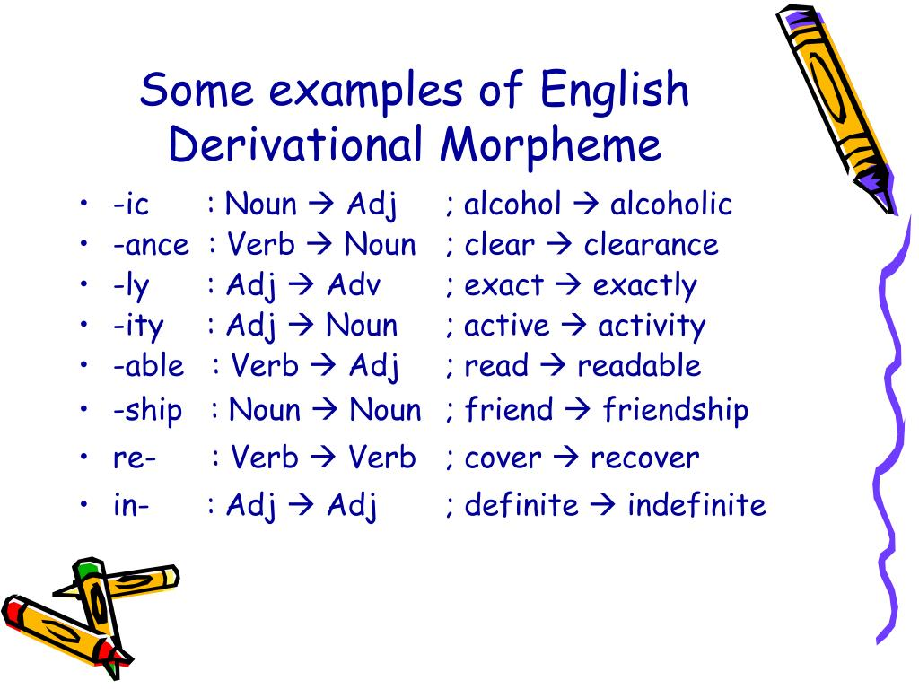

Slide 20
Regular Expressions

Slide 21
Some Questions on Regular Expression.....

Slide 22
What is Regular Expression?
What does the command ab+c search for?
ac,abc,abbc, and so on
ab,abc,abcc and so on
abc,abbc,abbbc and so on
None of the above
The number of matches does the command a{1,3} give with the string aabbaaaa?
3
2
1
4

Slide 23
What is the output of the below code?
print(re.match(‘On’,”one”))
'e'
Match Object
‘n’
None
What does the sequence \D finds the match?
Decimal digits
Non-decimal digits
Division
None of the above
Which of the following command is used to search a match for 1,2,3,4?
[1-4]
(1-3)
[1234]
Both a and c

Slide 24
What is the output of the below code?
re.sub(‘a’,’u’,’aeiou!’)
'ueiou!'
'eiou!'
'eio!'
None of the above

Slide 25
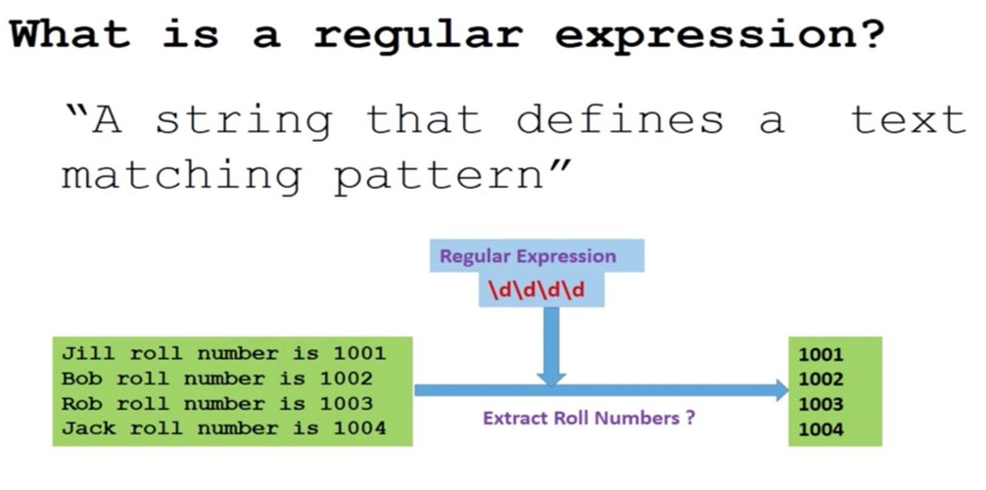

Slide 26
What is Regular Expression?
A Formal Language for specifying text search strings
A regular expression is an algebraic notation for characterizing a set of strings.
Regular expression search function will search through the corpus, returning all texts that match the pattern or the first match.
The corpus can be a single document or a collection

Slide 27
Regular expressions
The simplest kind of regular expression is sequence of simple characters
A formal language for specifying text strings
How can we search for any of these?
woodchuck
woodchucks
Woodchuck
Woodchucks
Regular expressions are case sensitive
All the above are different regular expression

Slide 28
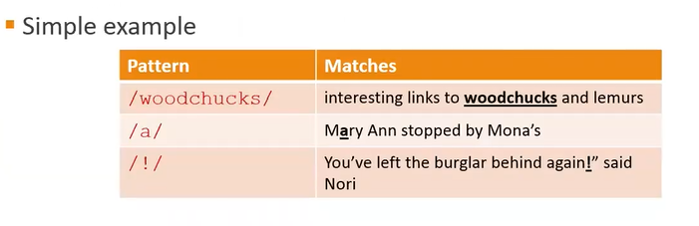
Regular Expression

Slide 29
Regular Expressions: Disjunctions
Letters inside square brackets []
Ranges [A-Z]
Pattern | Matches
[wW]oodchuck | Woodchuck, woodchuck
[1234567890] | Any digit
Pattern | Matches
[A-Z] | An upper case letter | Drenched Blossoms
[a-z] | A lower case letter | my beans were impatient
[0-9] | A single digit | Chapter 1: Down the Rabbit Hole

Slide 30
Regular Expressions: Negation in Disjunction
Negations [^Ss]
Carat means negation only when first in []
Pattern | Matches
[^A-Z] | Not an upper case letter | Oyfn pripetchik
[^Ss] | Neither ‘S’ nor ‘s’ | I have no exquisite reason”
[^e^] | Neither e nor ^ | Look here
a^b | The pattern a carat b | Look up a^b now

Slide 31
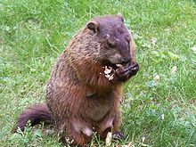
Regular Expressions: More Disjunction
Woodchuck is another name for groundhog!
The pipe | for disjunction
Pattern | Matches
groundhog|woodchuck | woodchuck
yours|mine | yours
a|b|c | = [abc]
[gG]roundhog|[Ww]oodchuck | Woodchuck

Slide 32
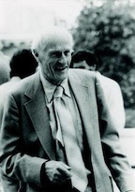
Regular Expressions: ? *+.
Pattern | Matches
colou?r | Optional previous char | color colour
oo*h! | 0 or more of previous char | oh! ooh! oooh! ooooh!
o+h! | 1 or more of previous char | oh! ooh! oooh! ooooh!
baa+ |  | baa baaa baaaa baaaaa
beg.n |  | begin begun begun beg3n
Stephen C Kleene
Kleene *, Kleene +

Slide 33
Regular Expressions: Anchors ^ $
Pattern | Matches
^[A-Z] | Palo Alto
^[^A-Za-z] | 1 “Hello”
\.$ | The end.
.$ | The end? The end!
993, 99
If your pattern is 99 it will be matched to both above string if you want to match only 99 you can use \b99\b

Slide 34
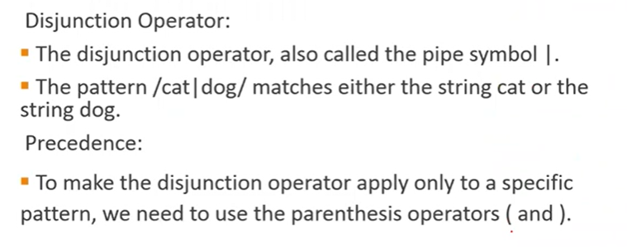

Slide 35
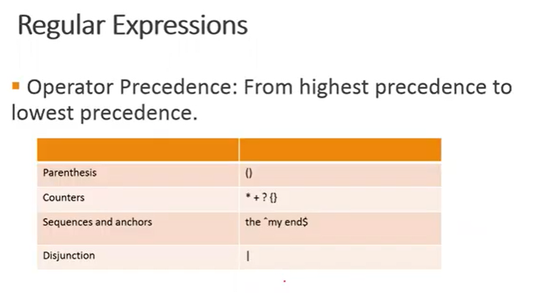

Slide 36
Example
Find me all instances of the word “the” in a text.
the
Misses capitalized examples
[tT]he
Incorrectly returns other or theology
[^a-zA-Z][tT]he[^a-zA-Z]

Slide 37
Errors
The process we just went through was based on fixing two kinds of errors:
Matching strings that we should not have matched (there, then, other)
False positives (Type I errors)
Not matching things that we should have matched (The)
False negatives (Type II errors)

Slide 38
Errors cont.
In NLP we are always dealing with these kinds of errors.
Reducing the error rate for an application often involves two antagonistic efforts:
Increasing accuracy or precision (minimizing false positives)
Increasing coverage or recall (minimizing false negatives).

Slide 39
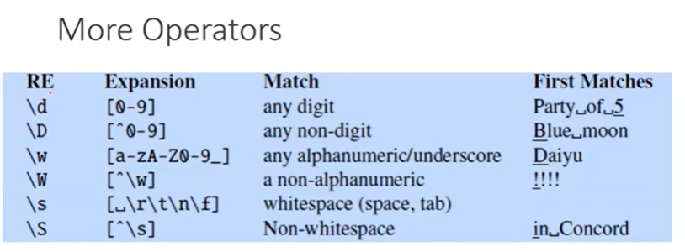

Slide 40
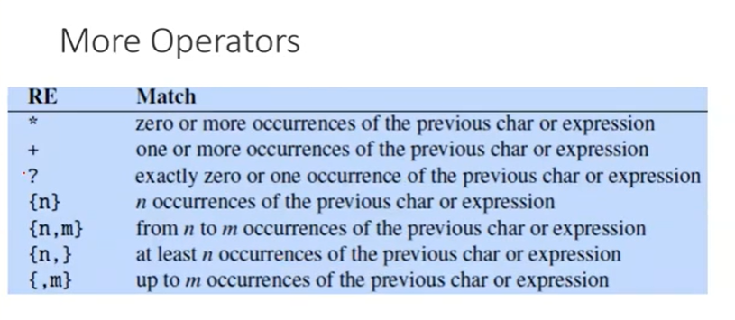

Slide 41
Summary
Regular expressions play a surprisingly large role
Sophisticated sequences of regular expressions are often the first model for any text processing text
For hard tasks, we use machine learning classifiers
But regular expressions are still used for pre-processing, or as features in the classifiers
Can be very useful in capturing generalizations

Slide 42
More Regular Expressions:
Substitutions and ELIZA
Notes:
Regular expression play a very powerful role when they are used to change strings, substituting one string for another. And this power to easily model string substitutions turns out to play a role in one of the earliest NLP systems, the pioneering 1966 chatbot ELIZA.

Slide 43
Substitutions
Substitution in Python and UNIX commands:
s/regexp1/pattern/
e.g.:
s/colour/color/
Notes:
The syntax for substitutions is simple. For example the python "S" command can be used to change a string matched by a regex to the substitute, another string.

Slide 44
Capture Groups
Say we want to put angles around all numbers:
the 35 boxes → the <35> boxes
Use parens () to "capture" a pattern into a numbered register (1, 2, 3…)
Use \1 to refer to the contents of the register
s/([0-9]+)/<\1>/
Notes:
It is often useful to be able to refer to a particular subpart of the string matching the first pattern. For that, we can use "capture groups", a way of storing part of the pattern into a "register" so we can refer to it later in the substitution string.

Slide 45
Capture groups: multiple registers
/the (.*)er they (.*), the \1er we \2/
Matches
the faster they ran, the faster we ran
But not
the faster they ran, the faster we ate
Notes:
In very complex patterns, we'll want to use more than one register; here's an example where we first capture two strings, and then refer to them both in order.

Slide 46
But suppose we don't want to capture?
Parentheses have a double function: grouping terms, and capturing
Non-capturing groups: add a ?: after paren:
/(?:some|a few) (people|cats) like some \1/
matches
some cats like some cats
but not
some cats like some some
Notes:
Here's a problem: parenthesis are used to specify capture groups. But they are also how we group terms, for example for disjunctions, like an expression for a string matching "people" or "cats". How do we specify that we are using the capture groups just for grouping and not for capturing? We simply add a "question mark colon" after the open paren.

Slide 47
Lookahead assertions
(?= pattern) is true if pattern matches, but is zero-width; doesn't advance character pointer
(?! pattern) true if a pattern does not match
How to match, at the beginning of a line, any single word that doesn’t start with “Volcano”:
/ˆ(?!Volcano)[A-Za-z]+/
Notes:
Finally, there will be times when we need to predict the future: look ahead in the text to see if some pattern matches, but not advance the match cursor, so that we can then deal with the pattern if it occurs.
These "lookahead assertions" make use of the (? syntax that we just introduced for non-capture groups. The operator (?= pattern) is true if the pattern occurs, but is zero-width, meaning the match pointer doesn’t advance. And the negative lookahead, ?! pattern only returns true if a pattern does not match, but again is zero-width. Negative lookahead is commonly used when we are parsing some complex pattern but want to rule out a special case. For example this last pattern here matches, at the beginning of a line, any single word that doesn’t start with “Volcano”.

Slide 48
Simple Application: ELIZA
Early NLP system that imitated a Rogerian psychotherapist
Joseph Weizenbaum, 1966.
Uses pattern matching to match, e.g.,:
“I need X”
and translates them into, e.g.
“What would it mean to you if you got X?
Notes:
Substitutions and capture groups are very useful in implementing simple chat-bots like ELIZA. ELIZA , one of the most important historical NLP systems, was created by pioneering AI researcher Joseph Weizenbaum in 1966, and simulates a Rogerian psychologist, a kind of therapist who emphasizes mirroring back what they hear. ELIZA is a surprisingly simple program that uses pattern matching to recognize phrases like “I need X” and translate them into suitable outputs like “What would it mean to you if you got X?”. This simple technique succeeds in this domain because ELIZA doesn’t actually need to know anything to mimic a Rogerian psychotherapist. This is one of the few dialogue genres where listeners can act as if they know nothing of the world.

Slide 49
Simple Application: ELIZA
Men are all alike. IN WHAT WAY
They're always bugging us about something or other. CAN YOU THINK OF A SPECIFIC EXAMPLE
Well, my boyfriend made me come here. YOUR BOYFRIEND MADE YOU COME HERE
He says I'm depressed much of the time. I AM SORRY TO HEAR YOU ARE DEPRESSED
Notes:
Here's some fragments from a sample conversation with ELIZA in 1966. Eliza’s mimicry of human conversation was remarkably successful: many people who interacted with ELIZA came to believe that it really understood them and their problems, and in very prescient early work, Weizenbaum pointed out the ethical issues in this attribution of human qualities to an artificial agent. We'll return to this issue in the dialogue lectures.

Slide 50
How ELIZA works
s/.* I’M (depressed|sad) .*/I AM SORRY TO HEAR YOU ARE \1/
s/.* I AM (depressed|sad) .*/WHY DO YOU THINK YOU ARE \1/
s/.* all .*/IN WHAT WAY?/
s/.* always .*/CAN YOU THINK OF A SPECIFIC EXAMPLE?/
Notes:
ELIZA consists mainly of a series of substitution patterns, with some control for deciding what pattern to select, and some higher-level dialogue structure that we'll come back to. Here we can see examples of capture groups for capturing the adjectives the user writes to describes themselves, and simple patterns for asking more details when the user uses generic statements containing "all" or "always".

Slide 51
Write the regular expression for the following
Write the regular expression that matches a string that has an a followed by zero or more b's
Write the regular expression for given language L = {E, a, aa, b,bb,ab,ba, aba, bab,.....},any combination of a and b.
Write the regular expression for the language L = {a, aba, aab, aba, aaa, abab, .....}
Write the regular expression for the language L = {a, aa,aaa, ....}
Write the regular expression for the language L = {E, 0, 1,00, 11,10,100,.....}
Write the regular expression for the language accepting all the string which are starting with 1 and ending with 0, over ∑ = {0, 1}.

Slide 52
Write the regular expression for the following
Write the regular expression that matches a string that has an a followed by zero or more b's R=ab*
Write the regular expression for given language L = {E, a, aa, b,bb,ab,ba, aba, bab,.....},any combination of a and b. Answer:-Solution
The regular expression will be −(a + b)*
Write the regular expression for the language L = {a, aba, aab, aba, aaa, abab, .....} R = {a + ab}*
Write the regular expression for the language L = {a, aa,aaa, ....} R = a+
Write the regular expression for the language L = {E, 0, 1,00, 11,10,100,.....}
R = (1* O*)
Write the regular expression for the language accepting all the string which are starting with 1 and ending with 0, over ∑ = {0, 1}. R = 1 (0+1)* 0

Slide 53
Finite State Automata
Finite Automata(FA) is the simplest machine to recognize patterns.
The finite automata or finite state machine is an abstract machine that has five elements or tuples.
It has a set of states and rules for moving from one state to another, but it depends upon the applied input symbol.
Basically, it is an abstract model of a digital computer.
Finite automata have two states, Accept state or Reject state.
When the input string is processed successfully, and the automata reached its final state, then it will accept.

Slide 54
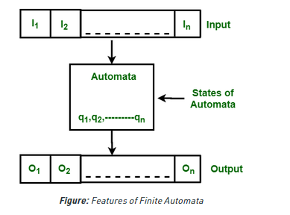
The above figure shows the following features of automata:
Input
Output
States of automata
State relation
Output relation

Slide 55
A Finite Automata consists of the following:
Q : Finite set of states. Σ : set of Input Symbols. q : Initial state. F : set of Final States. δ : Transition Function.

Slide 56
Deterministic Finite Automata (DFA):
DFA consists of 5 tuples {Q, Σ, q, F, δ}. Q : set of all states. Σ : set of input symbols. ( Symbols which machine takes as input ) q : Initial state. ( Starting state of a machine ) F : set of final state. δ : Transition Function, defined as δ : Q X Σ --> Q.
In a DFA, for a particular input character, the machine goes to one state only.
A transition function is defined on every state for every input symbol.
Also in DFA null (or ε) move is not allowed, i.e., DFA cannot change state without any input character.

Slide 57
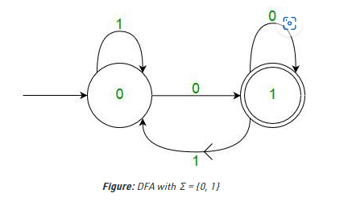
For example, below DFA with Σ = {0, 1} accepts all strings ending with 0.

Slide 58
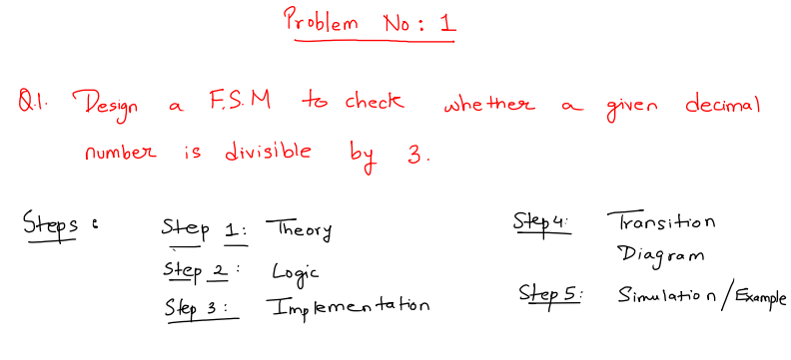

Slide 59
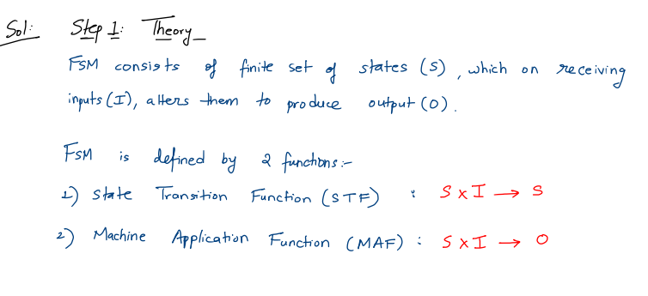

Slide 60
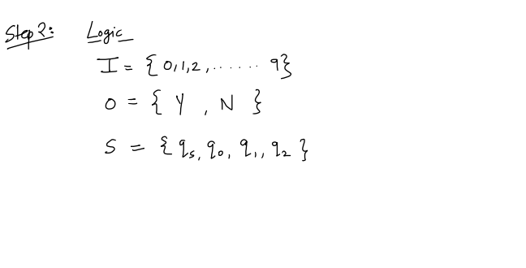

Slide 61
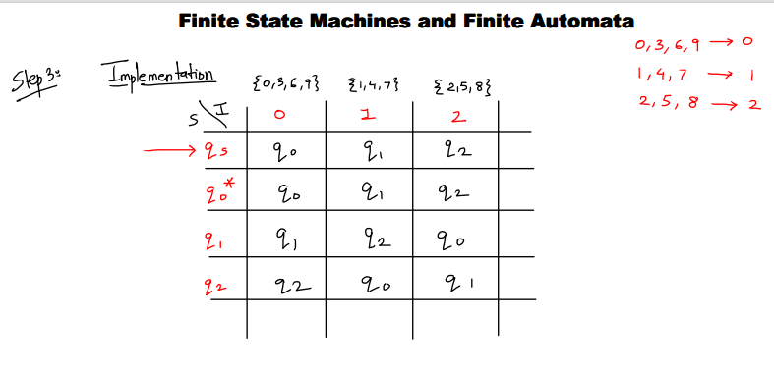

Slide 62
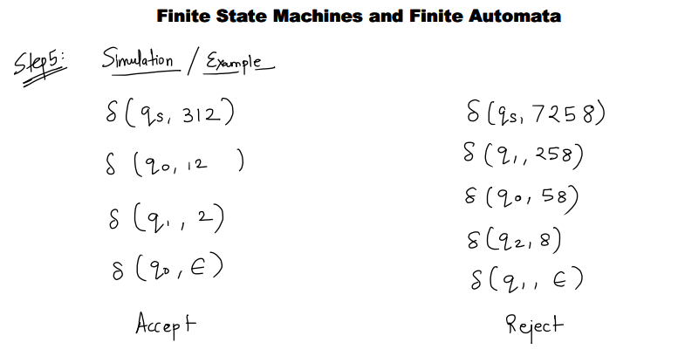

Slide 63
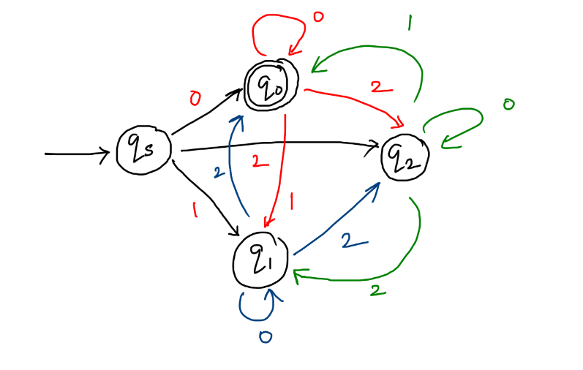
State Transition Diagram

Slide 64
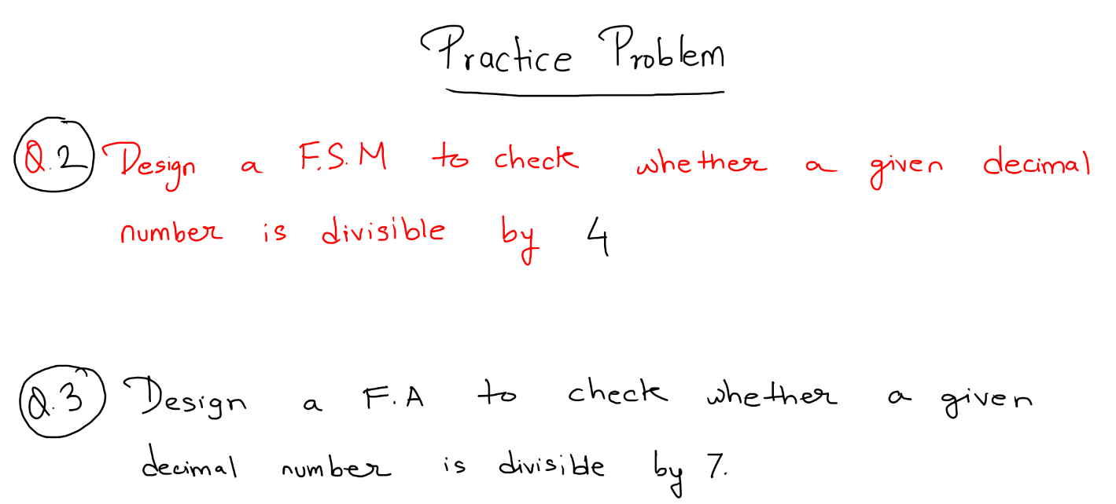

Slide 65
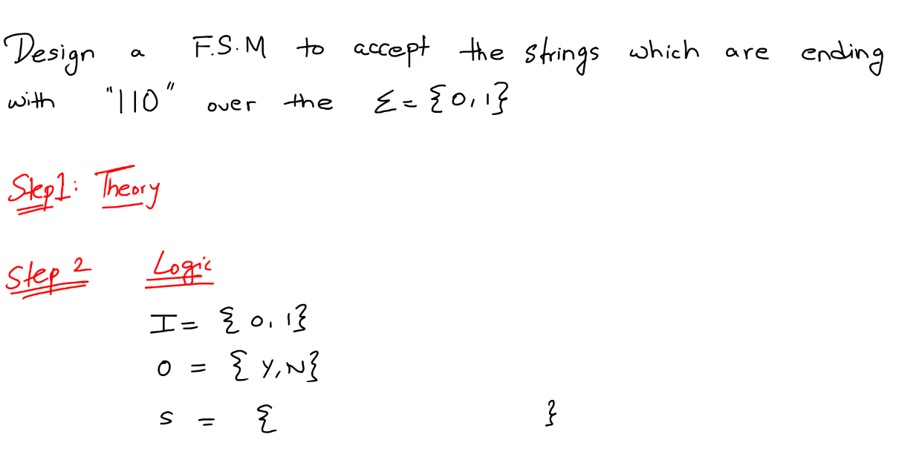

Slide 66
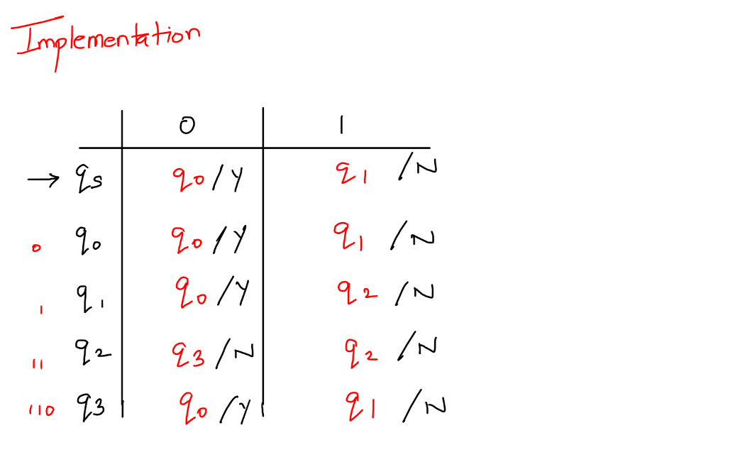



Slide 67
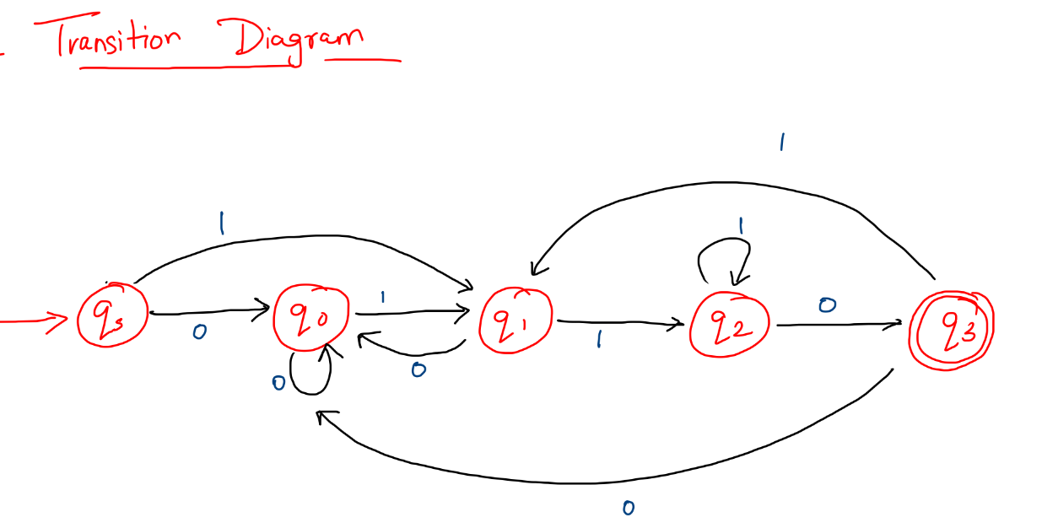

Slide 68
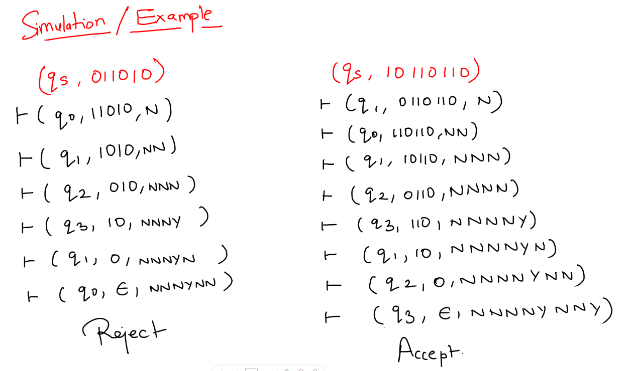





Slide 69
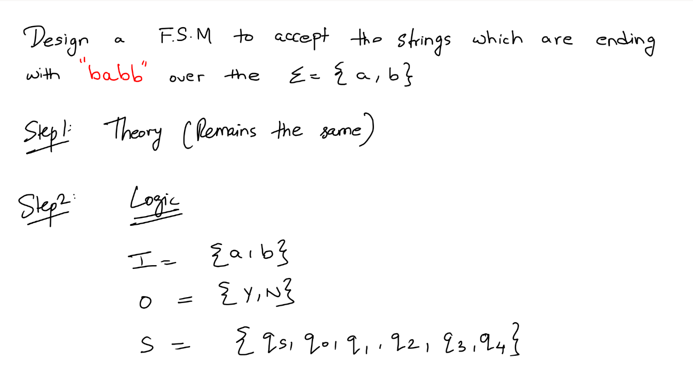

Slide 70
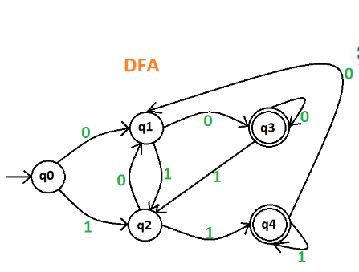
Draw a deterministic finite automate which accept 00 and 11 at the end of a string containing 0, 1 in it, e.g., 01010100 but not 000111010.

Slide 71

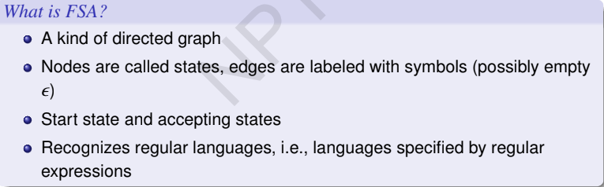

Slide 72
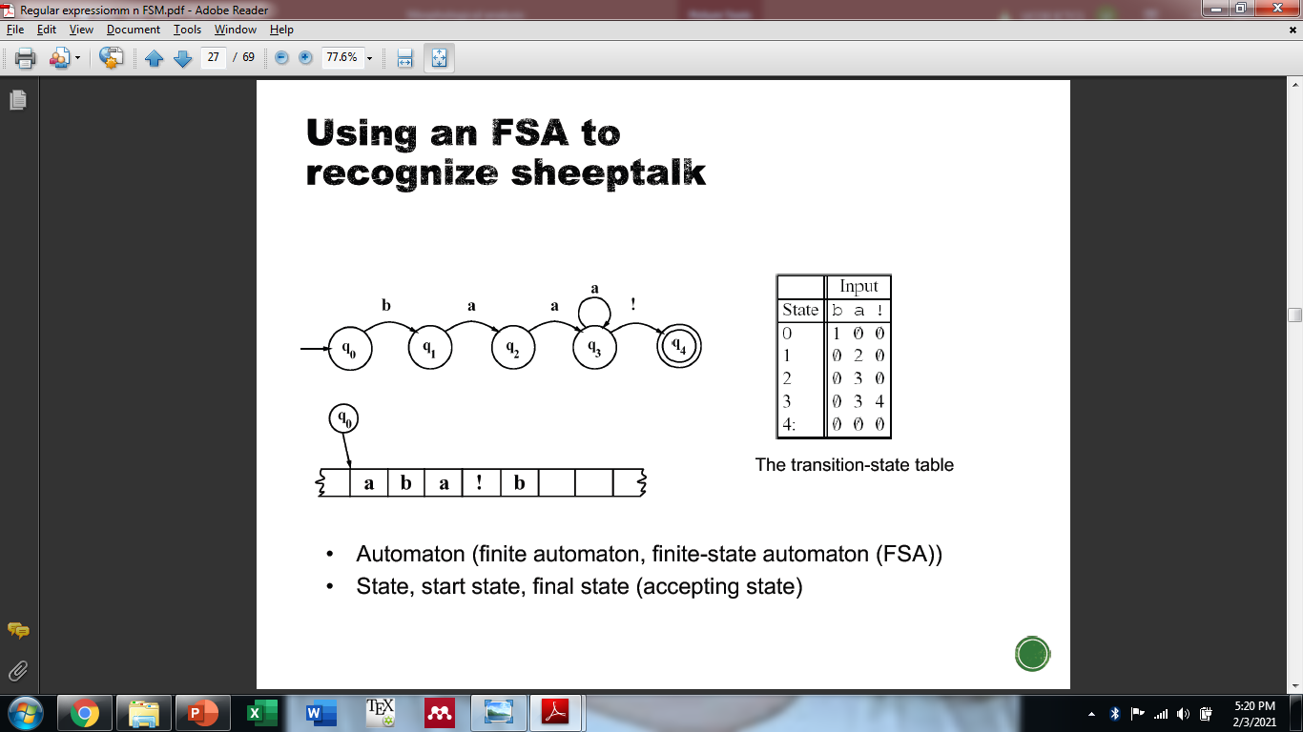
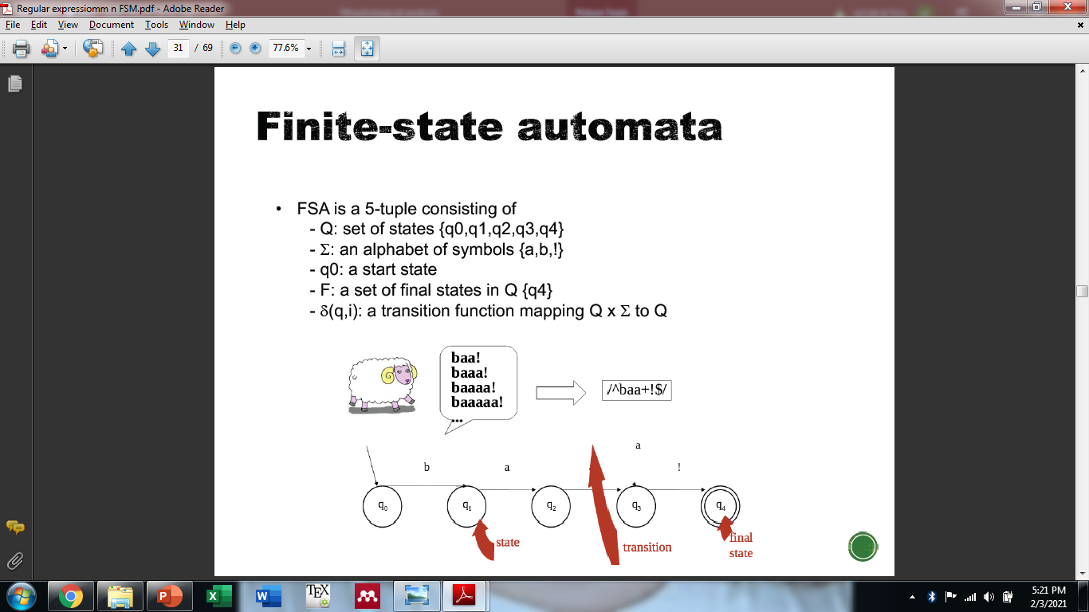

Slide 73
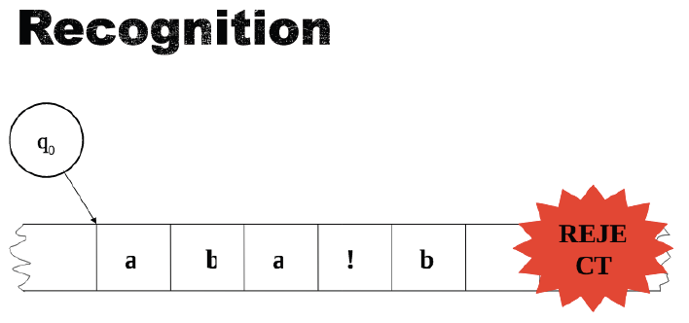

Slide 74
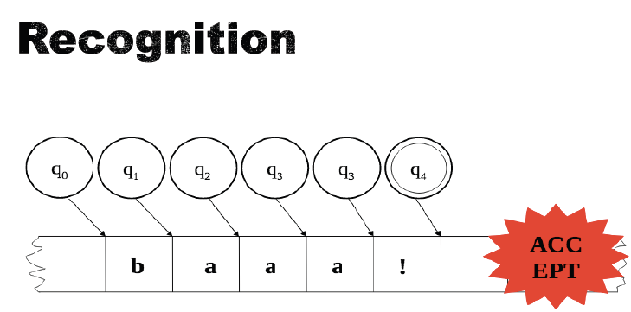

Slide 75

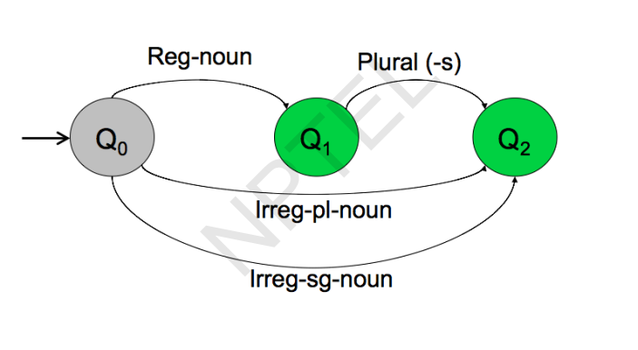

Slide 76

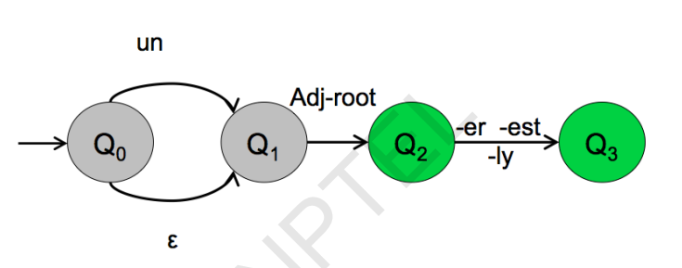
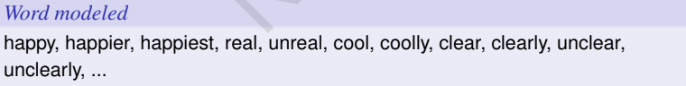

Slide 77
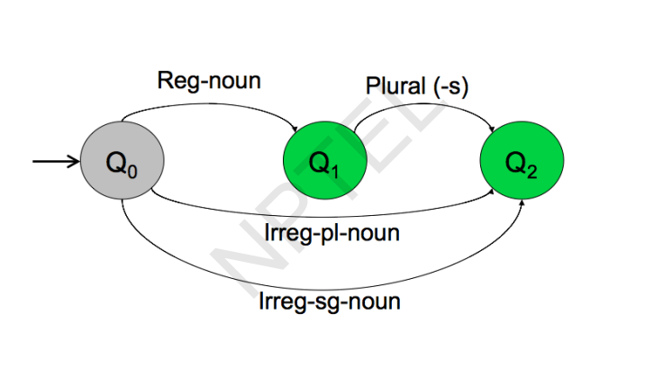

Slide 78
Finite-state can capture the generalization here:
Eg.
I eat Sushi
Ram like Mango
Noun+ Verb Noun+

Slide 79
Language is recursive
§ the ball
§ the ball in the garden
§ the ball in the garden behind the house
§ the ball in the garden behind the house next to school
§ the ball
§ the big ball
§ the big, red ball
§ the big, red, heavy ball

Slide 80
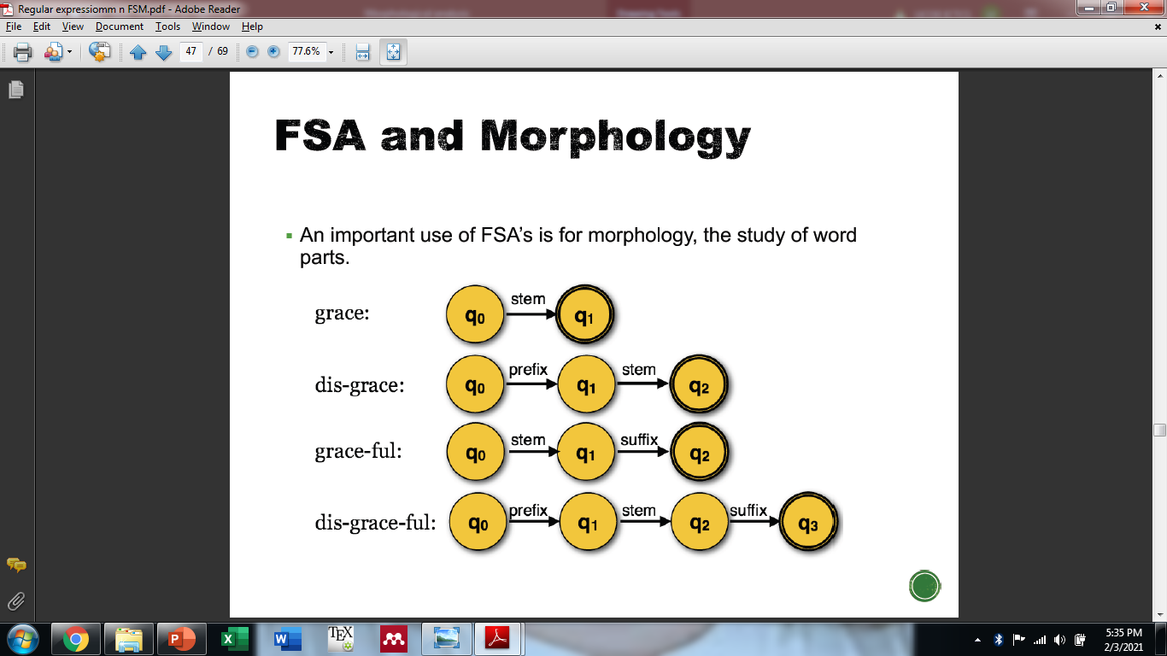

Slide 81
Morphological Parsing
Morphological parsing is to find the lexical form of a word from its surface form.​
Stem-----→Prefix+Stem+Suffix​
•
–cats ------------ cat +N +PLU
–cat ------------- cat +N +SG
–goose ------------goose +N +SG
–geese ------------goose +N +PLU
–catch ------------catch +V
–caught -----------catch +V +PAST
Surface Form
Lexical Form

Slide 82
Parts of A Morphological Processor
•Lexicon: The list of stems
with basic information about
categories (noun, verb, adjective, …)
sub-categories (regular noun, irregular noun, …)
•Morphotactics: Explains ordering -which classes of morphemes can follow other classes of morphemes inside a word.
•Orthographic Rules (Spelling Rules): These spelling rules are used to model changes that occur in a word (normally when two morphemes combine).

Slide 83
Lexicon
•A lexicon is a repository for words (stems).
•They are grouped according to their main categories.
–noun, verb, adjective, adverb, …
•They may be also divided into sub-categories.
–regular-nouns, irregular-singular nouns, irregular-plural nouns
•The simplest way to create a morphological parser, put all possible words (together with its inflections) into a lexicon.

Slide 84
Morphotactics

Slide 85

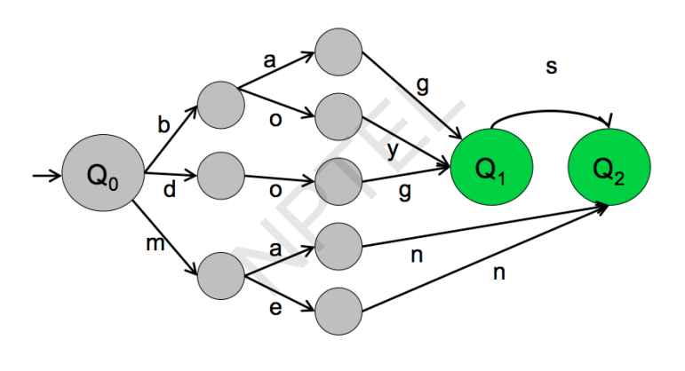

Slide 86

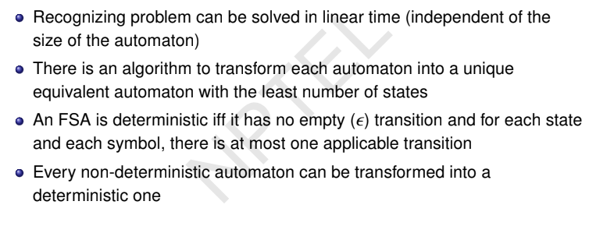

Slide 87
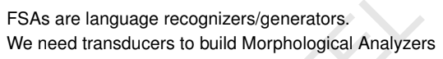
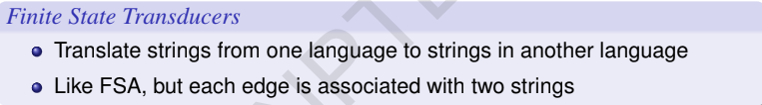
We cannot find Say What is Lemma for the word Boys.

Slide 88
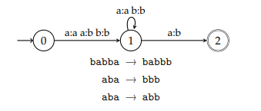
Finite state transducers
A finite state transducer essentially is a finite state automaton that works on two (or more) tapes. The most common way to think about transducers is as a kind of ``translating machine''.
They read from one of the tapes and write onto the other. This, for instance, is a transducer that translates as into bs:

Slide 89
Finite state transducers
A finite state transducer (FST) is a finite state machine where transitions are conditioned on a pair of symbols
The machine moves between the states based on input symbol, while it outputs the corresponding output symbol
An FST encodes a relation, a mapping from a set to another . The relation defined by an FST is called a regular (or rational) relation

Slide 90

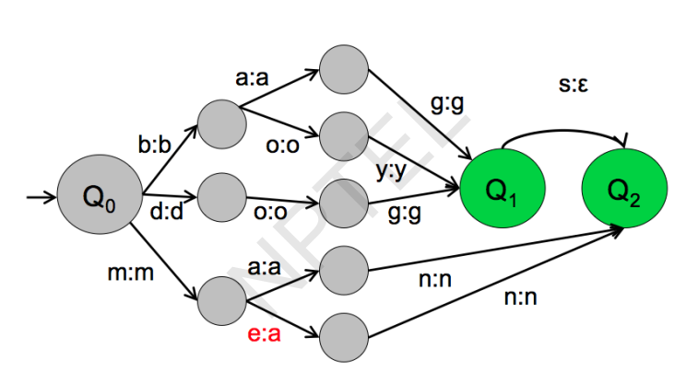

Slide 92

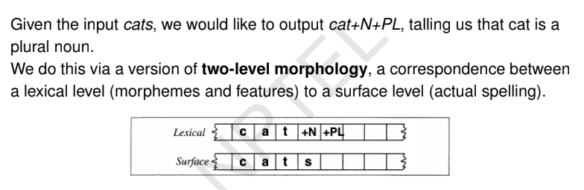

Slide 93
Two-Level Morphology
Two-level morphology represents the correspondence between lexical and surface levels.
•We use a finite-state transducer to find mapping between these two levels.
•A FST is a two-tape automaton:
–Reads from one tape and writes to other one.
•For morphological processing, one tape holds lexical representation, the second one holds the surface form of a word.

Slide 94
Morphological segmentation (or Stemming)
Taking a surface input and breaking it down into its morphemes
cat- cat+N+SL
cats- cat+N+PL
Plays- Play+V+3Singular
Played- Play+V+ PastParticipat
foxes – fox+N+PL

Slide 96
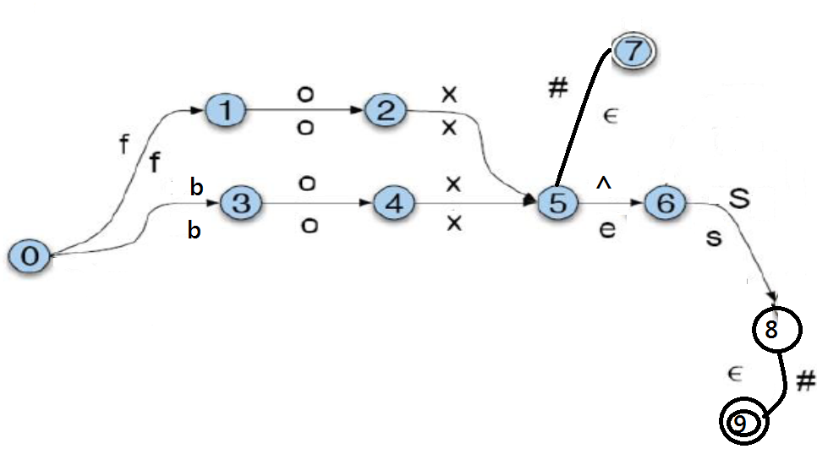
+Sg
#

Slide 97
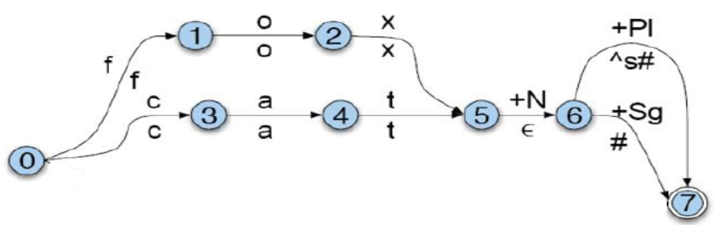
+Sg
#

Slide 98
For each spelling rule we will have a FST, and these FSTs run parallel.

Slide 99
Orthographic Rules
•For each spelling rule we will have a FST, and these FSTs run parallel.
•We represent these rules using two-level morphology rules:
a => b / c __ d
rewrite a as b when it occurs between c and d.
English Spelling Rules:
––E insertion --e added after s, z, x, ch, sh before s --watch/watches

Slide 100
Stemming
Stemming is suffix stripping operation
Process of reducing word into its base form (Root form/stem form)
This is achieved by cutting of begging or end of the word
Eg:
Playing- Play
Boys- Boy
Popular Algorithm is Porter Stemmer

Slide 101
Porter Stemmer
– Five sets of rules, applied in order
– Within each set, if more than one of the rules can apply, only the one with the longest matching suffix (S1) is followed
Advantage: easy to see understand, easy to implement.

Slide 102
Convention
Consonant( C ): other than A, E, I, O or U, and other than Y preceded by a consonant.
So in TOY the consonants are T and Y
Vowel(V) : Any other letter.

Slide 103
Any word in English has this forms:
[C](_{VC}^{m})[V]
[]denotes arbitrary presence of content
C-Consonant
V-Vowel
m will be called the measure of any word or word part
m=0 TR, EE, TREE, Y, BY.
m=1 TROUBLE, OATS, TREES, IVY.
m=2 TROUBLES, PRIVATE, OATEN, ORRERY.

Slide 104
RULES
The rules for removing a suffix will be given in the form (condition) S1 -> S2 if a word ends with the suffix S1 will be replaced by S2, if it satisfies the given condition.
e.g. (m > 1) EMENT -> Є Here S1 is 'EMENT' and S2 is null.
REPLACEMENT to REPLAC,
since REPLAC is a word part for which m = 2.

Slide 105
Condition part | Meaning
*S | the stem ends with S (and similarly for the other letters).
*v* | the stem contains a vowel. m=2 TROUBLES, PRIVATE, OATEN, ORRERY.
*d | the stem ends with a double consonant (e.g. -TT, -SS).
*o | the stem ends cvc, where the second c is not W, X or Y (e.g. -WIL, -HOP).
E.g. (m>1 or *S)

Slide 106
PORTER STEMMER
Step 1a :
sses -> ss (Example : caresses -> caress)
ies -> i (Example : ponies -> poni ; ties -> ti)
ss -> ss (Example : caress -> caress)
s ->Є (Example : cats -> cat)

Slide 107
Step 1b :
(m>0) eed -> ee (Example : agreed -> agree; feed -> feed )
(*v*) ed -> є (Example : plastered -> plaster ; bled -> bled)
(*v*) ing -> є (Example : motoring -> motor ; sing -> sing)
s -> є (Example : cats -> cat)

Slide 108
If the second or third of the rules in Step 1b is successful, the following is done: Cleaning Step
at -> ate (Example : conflat(ed) -> conflate)
bl -> ble (Example : troubl(ed) -> trouble)
iz -> ize (Example : siz(ed) -> size)
s -> є (Example : cats -> cat)
(*d &! (*l or *s or *z)) -> single letter
(Example : hopp(ing) -> hop ; tann(ed) -> tan ; fall(ing) -> fall ; hiss(ing) -> hiss ; fizz(ed) -> fizz)
(m=1 and *o) -> e
(Example : fil(ing) -> file); fail(ing) -> fail

Slide 109
Step 1c : Y Elimination
( \*v\*) y -> i (Example : happy -> happi ; sky -> sky)
Step 1 deals with plurals and past participles. The subsequent steps are much more straightforward.
Step 2 :Derivational Morphology -1
(m>0) ational -> ate (Example : relational -> relate
(m>0) ization -> ize (generalization -> generalize)
(m>0) biliti -> ble (sensibiliti -> sensible)

Slide 110
Step 3 :
(m>0) icate -> ic (Example : triplicate -> triplic)
(m>0) ful -> є (Example : hopeful -> hope)
(m>0) ness -> є (Example : goodness -> good)

Slide 111
Step 4 :Derivational Morphology-II
( (m>1) ance -> є (Example : allowance -> allow)
(m>1) ment -> є(Example : adjustment -> adjust)
(m>1) ent -> є (Example : dependent -> depend)
(m>1) ive -> є (Example : effective -> effect)

Slide 112
The suffixes are now removed. All that remains is a little tidying up.
Step 5a :
(m>1) e -> є (Example : probate -> probat ; rate -> rate)
(m=1 and not *o) ness -> є (Example : goodness -> good)
Step 5b
(m > 1 and *d &*l) -> single letter
(Example : controll -> control ; roll -> roll)

Slide 113
Disadvantage
This indiscriminate cutting will be successful at some occasion and fail in some
Eg.
Studies- Studi
Giving- Giv
Intelligence-Intelligen
Produced immediate representation of the word may not have any meaning

Slide 114
Stemming Lemmatization
Cutting of Suffixes to extract stem
Eg.
Studies- Studi
Giving- Giv
Caring- Car
Produced immediate representation of the word may not have any meaning
Cutting of Suffixes to extract Lemma
Eg.
Studies- Study
Giving- Give
Caring- Care
Produced immediate representation of the word having meaning

Slide 115
Lemmatization
Same as Stemming but immediate representation have some meaning
Stemming and lemmatization both of these concepts are used to normalized the given word by removing affixes
Stemming | Lemmatization
Root word is called Stem | Root word is called Lemma
It does not need (Part of Speech) POS tagging | It needs POS tagging
Stemming does not require knowledge of the context | Lemmatization requires the context of the word in the sentence
Stemming requires less computational power | Lemmatization requires more computational power
Stemming is not used to make dictionary or WordNet kind of dictionary. | Lemmatization concept is used to make dictionary or WordNet kind of dictionary.
Eg. Caring-car | Eg. Caring-care
Application: Sentiment Analysis, Document Clustering, Machine Translation | Application: Sentiment Analysis, Document Clustering, Machine Translation

Slide 116
N-Gram Language Model
Predicting N^{th} word from N-1 words
Predicting 3rd word from previous 2 words – Model is called Trigram
Predicting 2nd word from previous 1 words – Model is called Bigram
He is going to _____ ← Predicting 5th word from last four words is 5 gram Language Model
going to _____ ← Predicting 3rd word from last two words is trigram

Slide 117
Application of N-Gram
Optical Character Recognition
Image → Text
If words are missing or not clear can be predicted
Grammar correction
Spelling is not correct then based on context can be suggested
If spelling is right
E.g. Deer sir instead of Dear sir can be correctly as, Sir is normally followed by Dear not Deer
Speech to Text
Words with different pronunciation. e.g. Eye am Fine & I am Fine
Translation
Multiple Synonym of words
E.g., He is biggest minister of Pakistan → Prime
Suggestion while typing in mobile text prediction mode.

Slide 118


He is going to school →Meaningful
He school is to going→ Doesn’t Make sense
For N-gram models
P(w1,w2, ...,wn)
By the Chain Rule we can decompose a joint probability, as follows:
P(w1,w2, ...,wn) = P(w1) P(w2|w1) P(w3|w1w2 ) P(wn|w1..., Wn-2 wn-1)
Join Probability of sentence
P(He is going to school)= P(He)P(is|He)P(going|He is)P(to|He is going)P(school|He is going to)
Looking back so much

